Slide 1
MY SQL
REAL TIME LOAN ANALYTICS HUB
Presented by
R.Srivarsen

Slide 2
CONTENTS
INTRODUCTION TO SQL
SQL DATA TYPES
SQL GENERAL FUNCTIONS
SQL CALCULATE FUNCTIONS
SQL STRING FUNCTION
SQL DATE FUNCTION
SQL LOGICAL FUNCTION
SQL JOOINS
PROCEDURES CONCEPTS
TRIGGERS

Slide 3
INTRODUCTION TO SQL
MySQL is a relational database management system based on the Structured Query Language, which is the popular language for accessing and managing the records in the database.
MySQL is open-source and free software under the GNU license.
It is supported by Oracle Company. It allows us to implement database operations on tables, rows, columns, and indexes.

Slide 4
DBMS
DBMS stands for Database Management System.
It is specifically designed to store, manage, define, and retrieve data in a database.
It primarily acts as an interface between the database and the end-user.

Slide 5
FEATURES OF DBMS
A DBMS library management system and user-accessible catalog with MetaData
Abstraction and Data Independence
Logging and Auditing of activity
Authorization and Remote access support
Transaction , concurrency and Data Recovery support
Data security

Slide 6
RDBMS
RDBMS stands for Relational Database Management System.
It is a subset of DBMS that is specifically designed to be more sophisticated and has a degree of finesse.
A relational database stores data in a structured format in the form of rows and columns. It has a tabular form that makes it convenient to locate and access specific data within the database.
The ‘relational’ in RDBMS comes from the fact that the values in a table are all related to each other.

Slide 7
DIFFERENCE BETWEEN DBMS AND RDBMS
Data is stored as a file
It supports single users
It does not support client-server architecture
No relationship between data.
Data is stored in the form of tables.
It supports multiple users.
It support client-server architecture
Data is stored in the form of tables which are related to each other.

Slide 8
SQL DATA TYPES
An SQL developer must decide what type of data that will be stored inside each column when creating a table.
The data type is a guideline for SQL to understand what type of data is expected inside of each column, and it also identifies how SQL will interact with the stored data

Slide 9
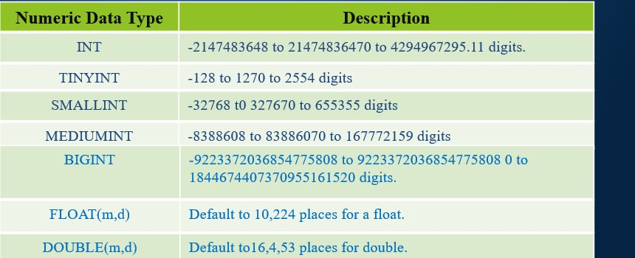
NUMERIC DATATYPE

Slide 10
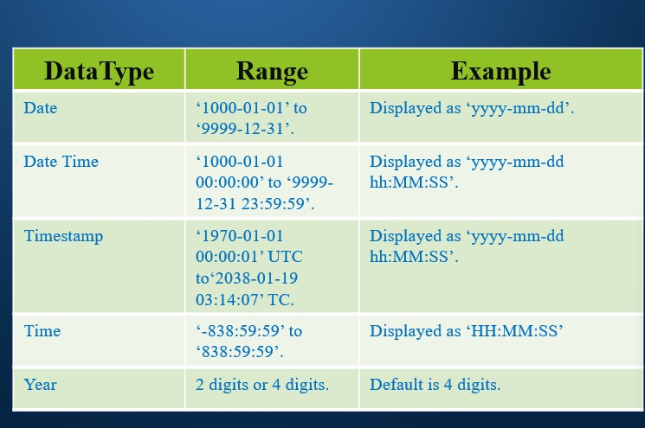
DATE TIME

Slide 11
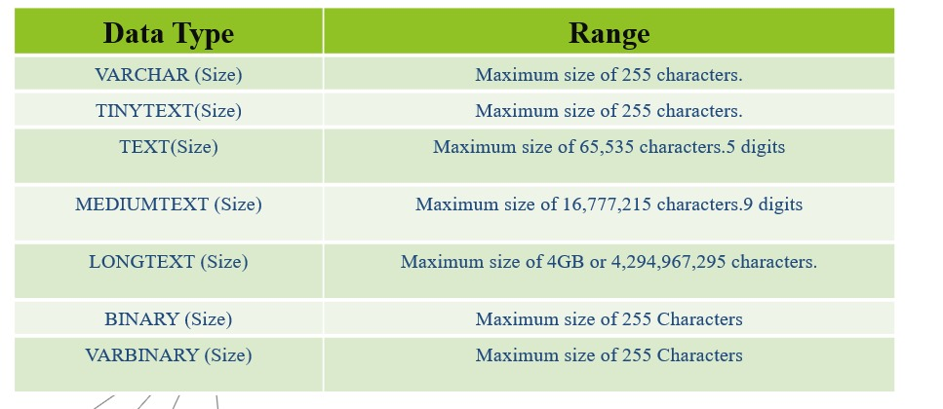
STRING TYPE

Slide 12
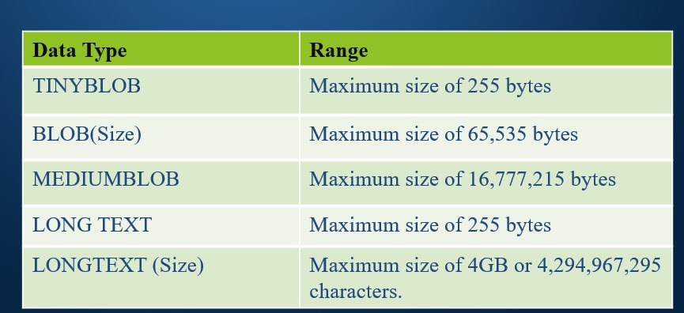
LARGE OBJECT(LOB) for file & Picture Saving

Slide 13
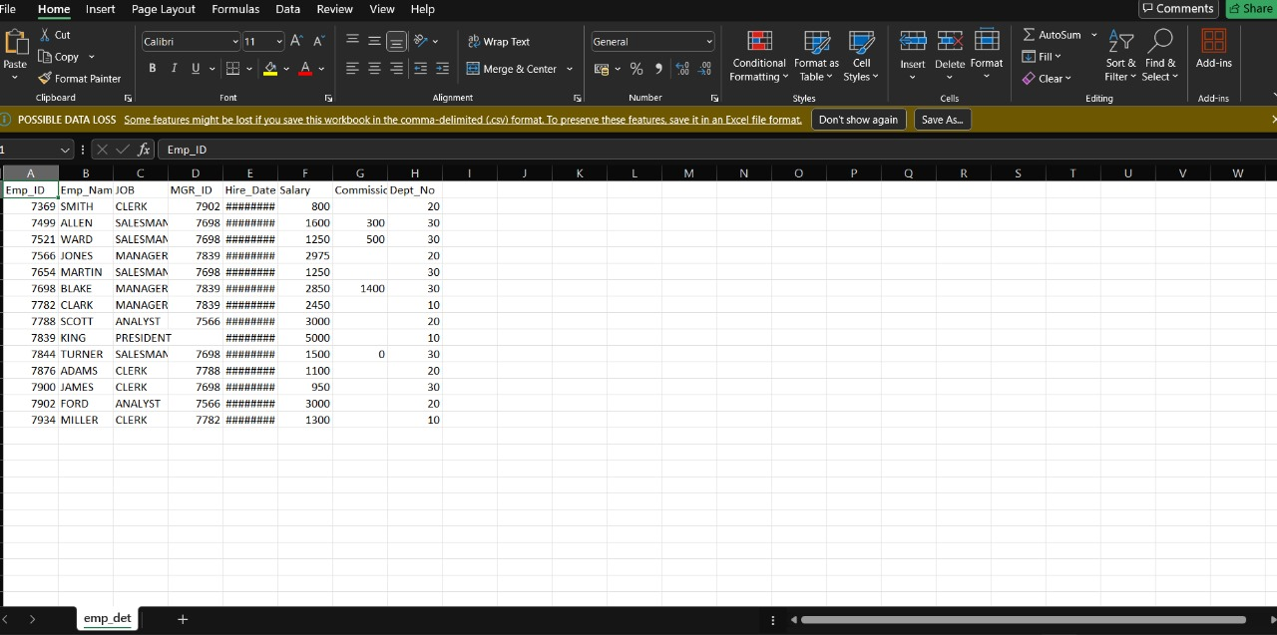
DATA SET

Slide 14
SQL GENERAL FUNCTIONS
Where
Or
And
In
Not in
>
<
<=
>=
<> (Not in)
!
Count
Distinct
Count with distinct
Order by Asc
Order by desc
Group by
Limit
Desc Limit
Like (__%)
Not like
Between

Slide 15
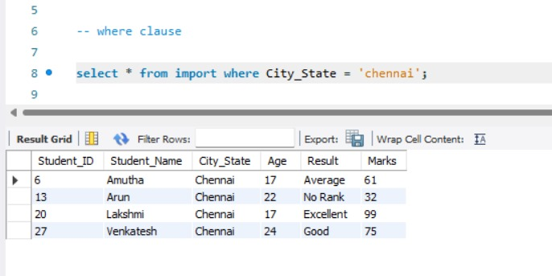
WHERE The where clause is used to filter records. It is used to extract only those records that fulfill a specified condition.

Slide 16
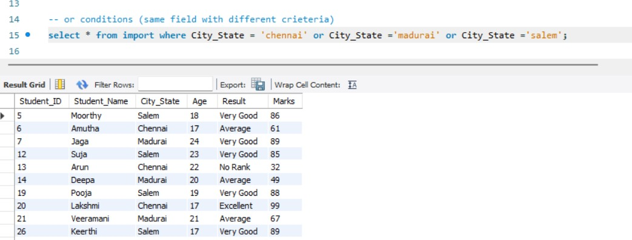
OR The where clause is used to filter records. It is used to extract only those records that fulfill a specified condition.

Slide 17
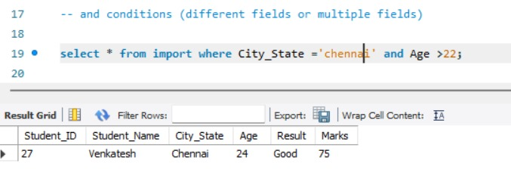
AND The where clause is used to filter records. It is used to extract only those records that fulfill a specified condition.

Slide 18
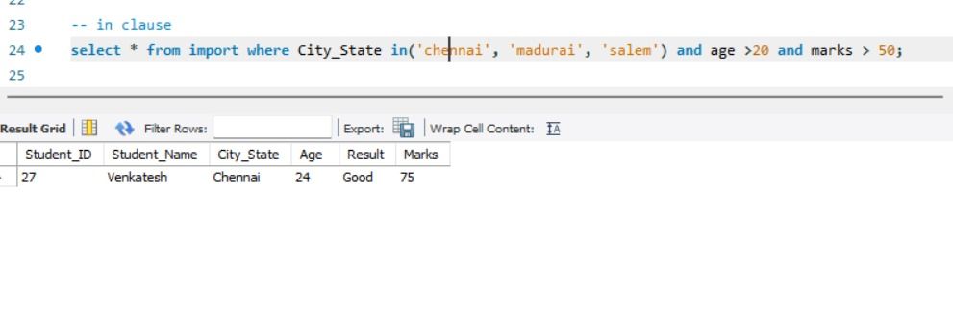
IN The IN operator allows you to specify multiple values in a WHERE clause

Slide 19
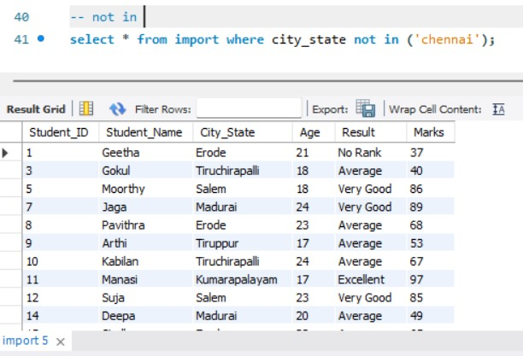
NOT IN The NOT IN operator can be used to search for any date or datetime value except those match that match one from a list of date or datetime values.

Slide 20
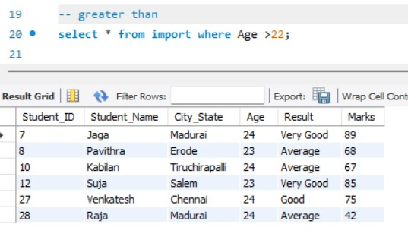
GREATER THAN The > operator in SQL to test for an expression greater than.

Slide 21
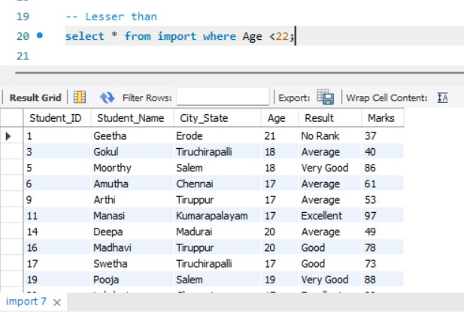
LESSER THAN The < operator in SQL to test for an expression LESSER than.

Slide 22
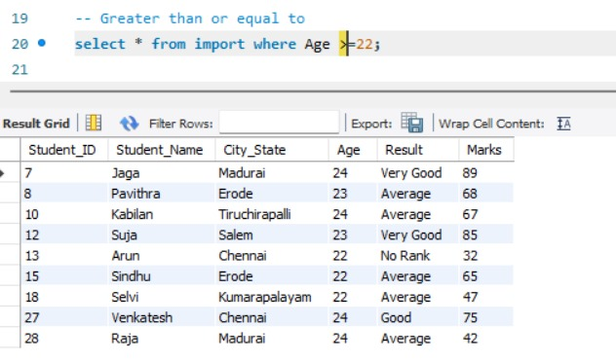
<= The <= operator to test for an expression greater than or equal to.

Slide 23
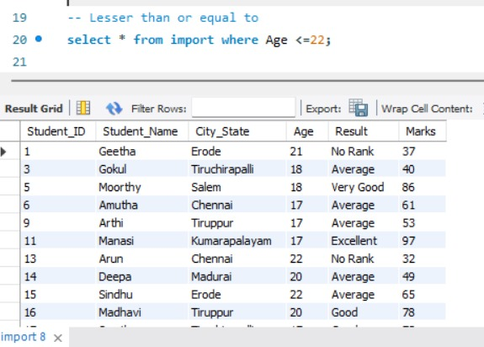
>= The >= operator to test for an expression less than or equal to.

Slide 24
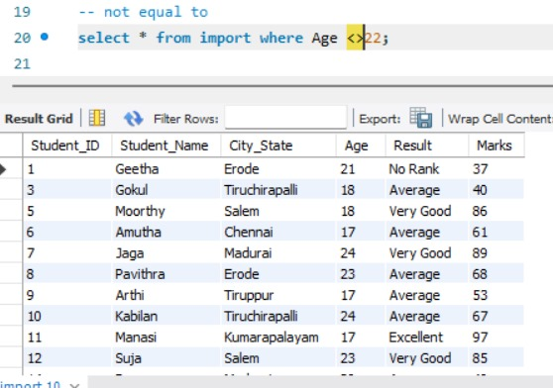
<> The SQL NOT EQUAL operator is used to compare two values and return true if they are not equal. It is represented by "<>" and "!="

Slide 25
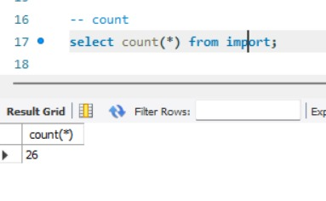
COUNT The COUNT() function returns the number of rows that matches a specified criterion.

Slide 26
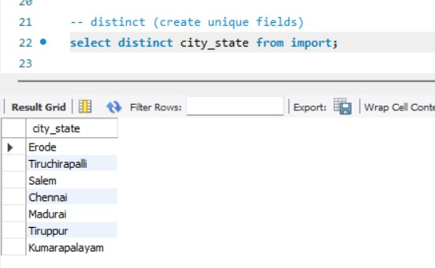
DISTINCT The SQL DISTINCT keyword is used in conjunction with the SELECT statement to fetch unique records from a table.

Slide 27
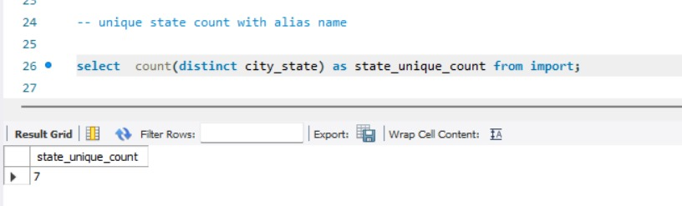
COUNT WITH DISTINCT SQL COUNT() function with DISTINCT clause eliminates the repetitive appearance of the same data. The DISTINCT can come only once in a given select statement.

Slide 28
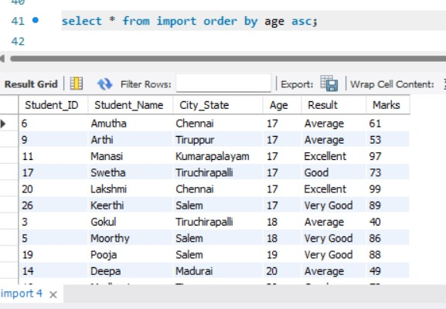
ORDER BY ASC The ORDER BY keyword is used to sort the result-set in ascending.

Slide 29
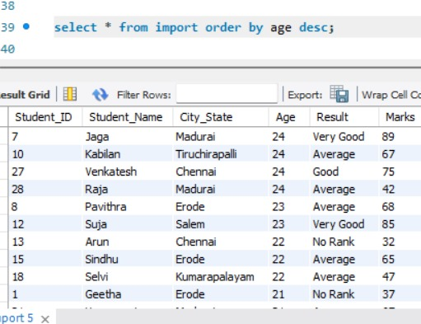
ORDER BY DESC The ORDER BY keyword is used to sort the result-set in descending order

Slide 30
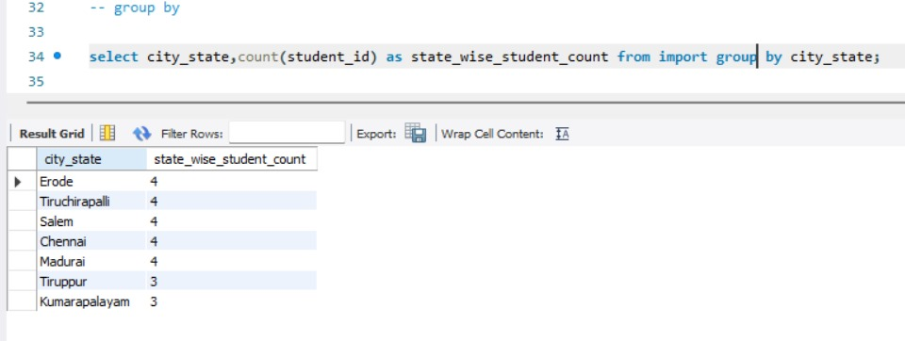
GROUP BY The GROUP BY statement groups rows that have the same values into summary rows

Slide 31
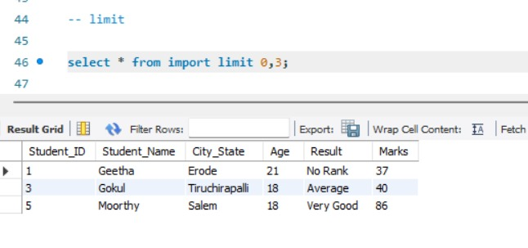
LIMIT The LIMIT clause is used to specify the number of records to return

Slide 32
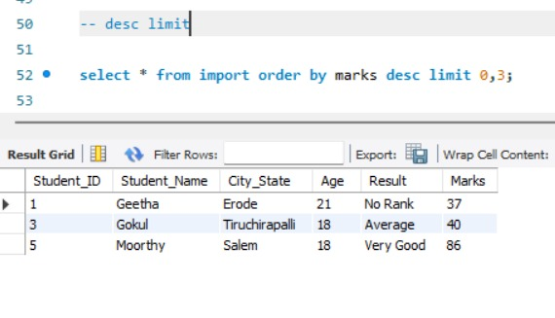
DESC LIMIT The DESC LIMIT clause specifies the results in descending order.

Slide 33
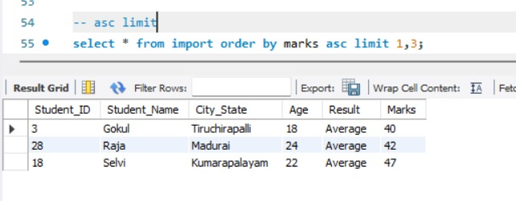
ASC LIMIT The ASC LIMIT clause specifies the results in Ascending order

Slide 34
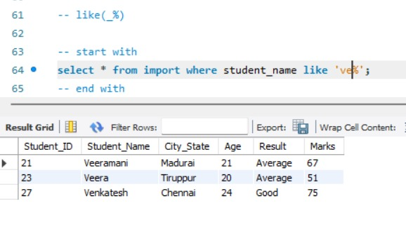
Like The SQL LIKE operator is used to retrieve the data in a column of a table, based on a specified pattern.

Slide 35
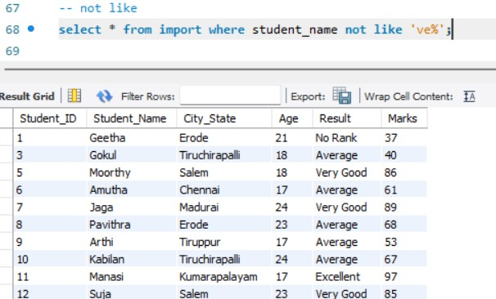
Not like Sometimes we want to get records that doesn’t match the like pattern. In that case we can use sql not like operator.

Slide 36
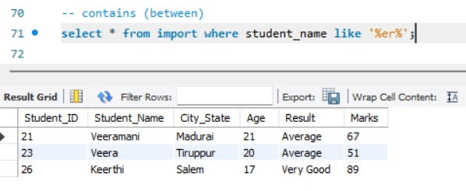
BETWEEN The BETWEEN operator selects values within a given range. The values can be numbers, text, or dates.

Slide 37
SQL CALCULATE FUNCTIONS

Slide 38
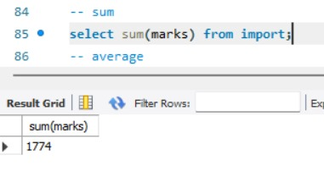
SUM THE SUM() function returns the total sum of numeric column.

Slide 39
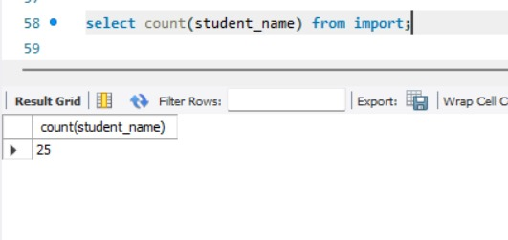
Count The COUNT() function returns the number of rows that matches a specified criterion

Slide 40
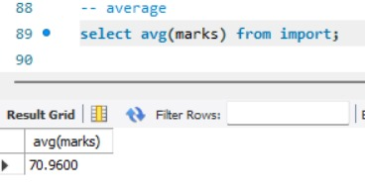
Average The AVG() function returns the average value of a numeric column

Slide 41
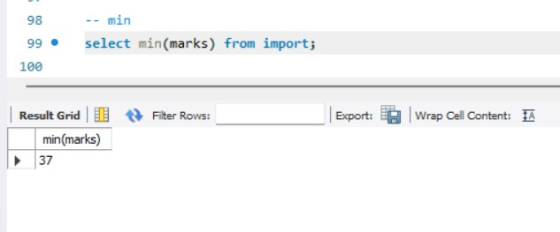
Min In SQL, the MIN function is used to find the minimum value in a set of values.

Slide 42
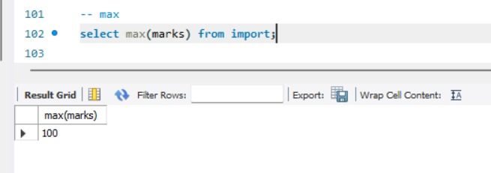
Max In SQL, the MAX function is used to find the maximum value in a set of values.

Slide 43
SQL STRING FUNCTION

Slide 44
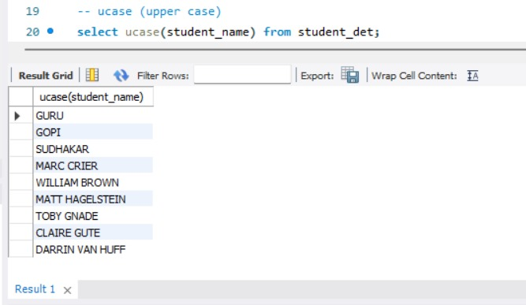
UCASE Returns a string that has all the characters in upper case

Slide 45
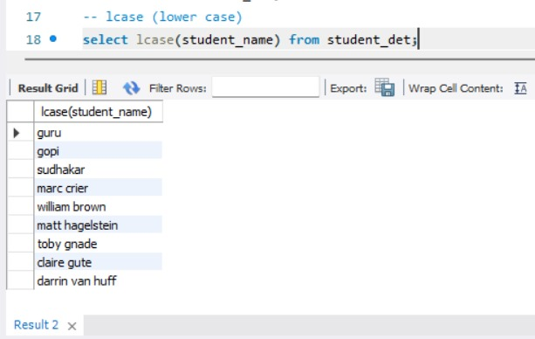
LCASE Returns a string that has all the characters in lower case

Slide 46
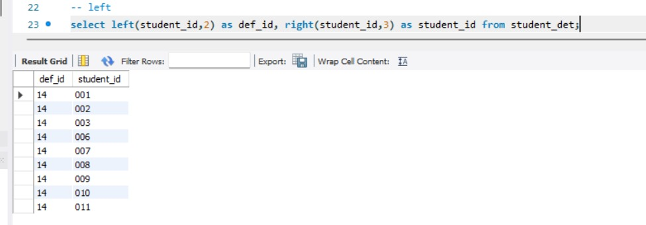
LEFT The LEFT() function extracts a number of characters from a string (starting from left).

Slide 47
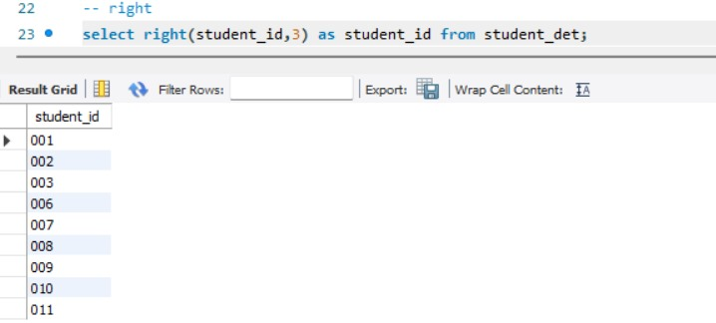
RIGHT The RIGHT() function extracts a number of characters from a string (starting from RIGHT).

Slide 48
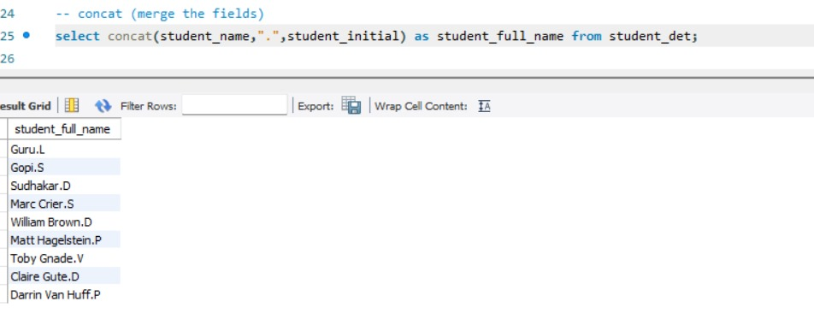
CONCAT The CONCAT() function adds two or more strings together.

Slide 49
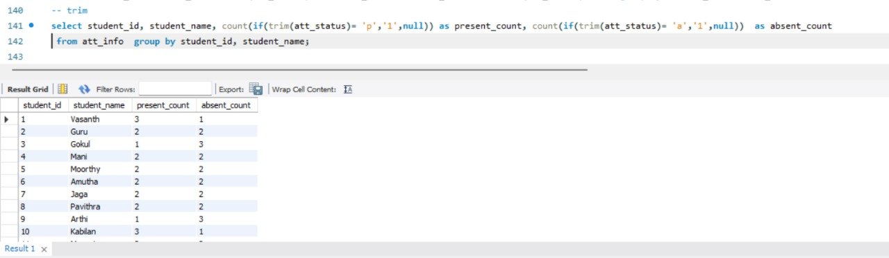
TRIM The TRIM() function removes the space character OR other specified characters from the start or end of a string.

Slide 50
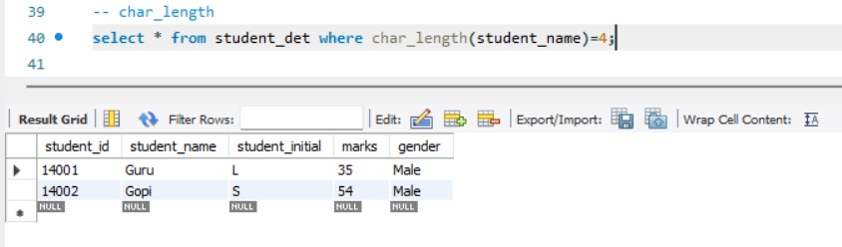
CHAR LENGTH The CHAR_LENGTH() function return the length of a string (in characters)

Slide 51
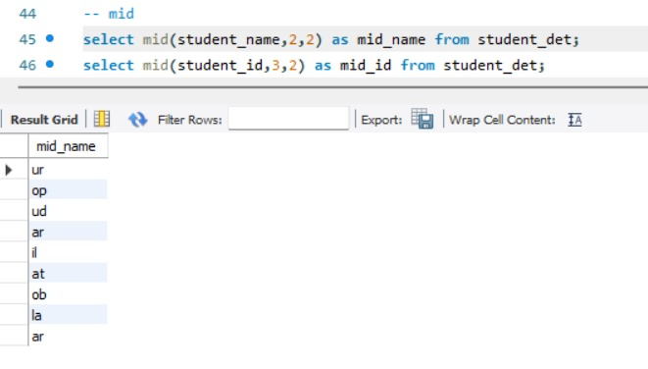
MID The MID() function extracts a substring from a string (starting at any position).

Slide 52
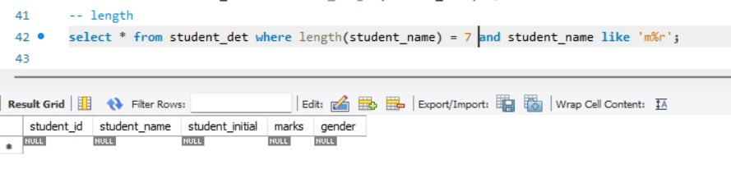
LENGTH The LENGTH() function returns the length of a string (in bytes).

Slide 53
SQL DATE FUNCTION

Slide 54
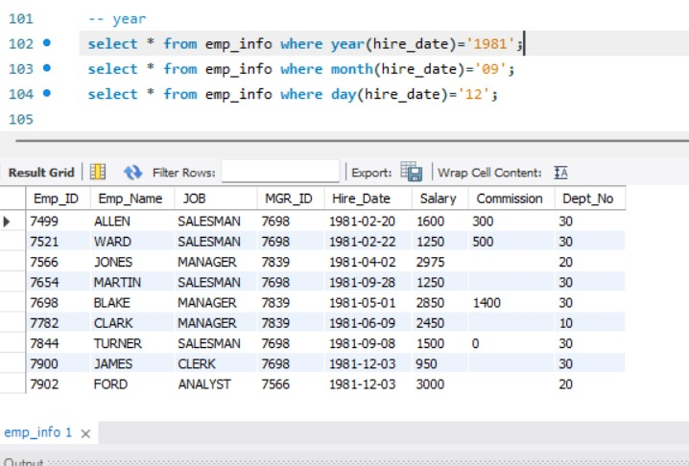
YEAR AND MONTH The MONTH() or YEAR() function returns the month part for a given date

Slide 55
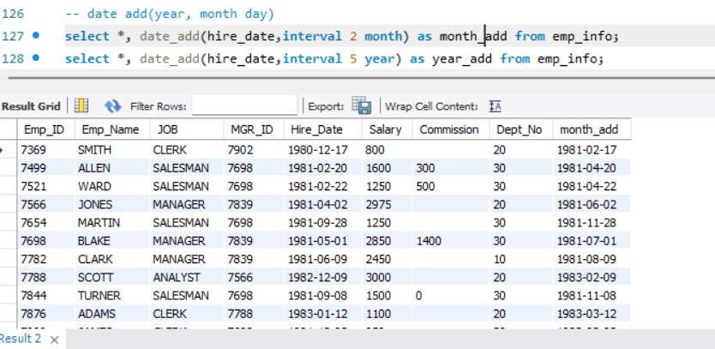
DATE ADD The DATE_ADD()function returns the interval of years or month.

Slide 56
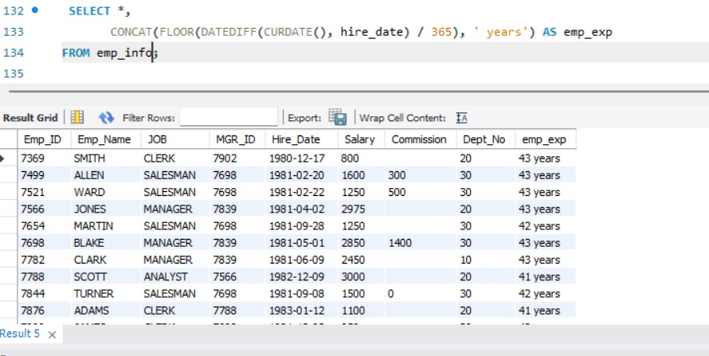
DATE DIFF The DATEDIFF()function returns the Experience of employee.

Slide 57
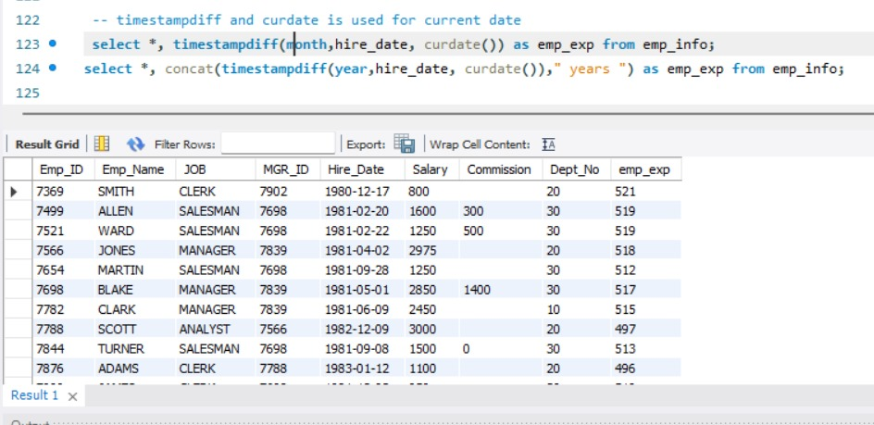
Time stampdiff The TIMESTAMPDIFF() function returns a datetime value based on a date or datetime value.

Slide 58
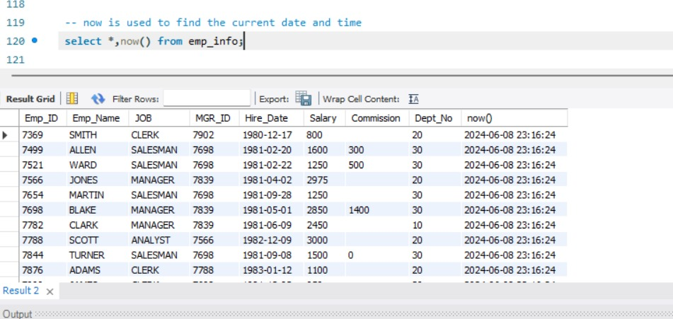
NOW The NOW() function returns the current date and time.

Slide 59
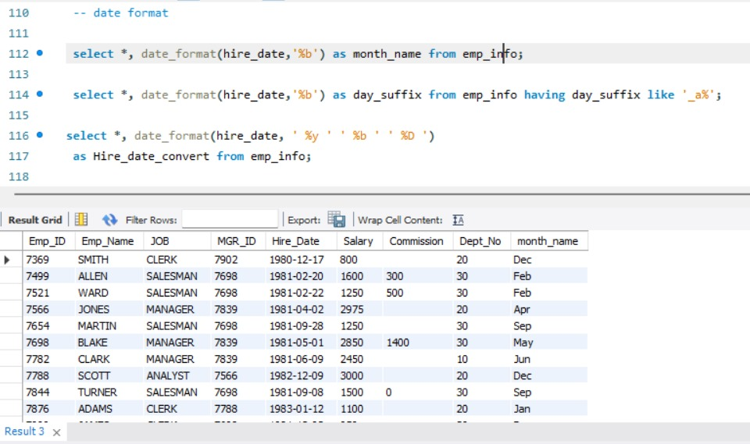
DATE FORMATE THE DATEFORMATE () FUNCTION FORMATES A DATE AS SPECIFIED

Slide 60
SQL LOGICAL FUNCTION

Slide 61
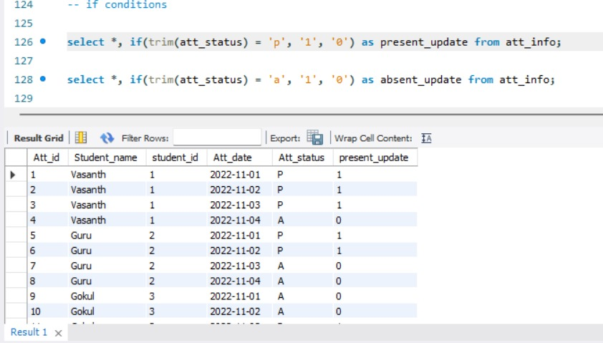
IF The IF() function returns a value if a condition is TRUE, or another value if a condition is FALSE.

Slide 62
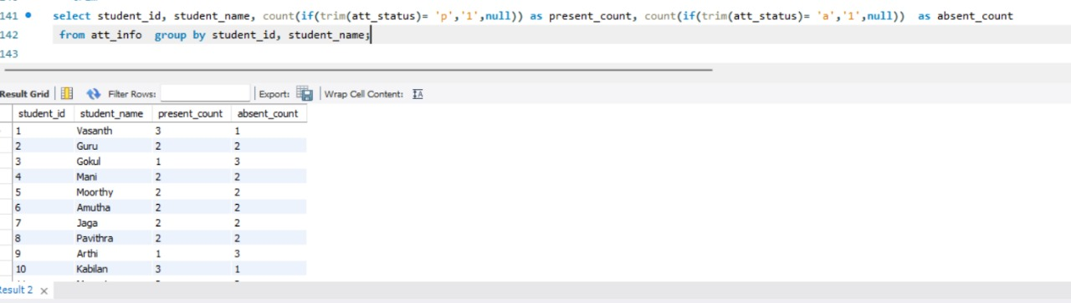
COUNT IF The "Count with If" query has the following syntax: The IF function, which assesses a condition and returns a value depending on whether the condition is true or false, is the crucial component in this situation

Slide 63
SQL JOINS

Slide 64
TYPES OF JOINS
inner join
left join
right join
full outer join (combination of both left and right join)
cross join
self join

Slide 65
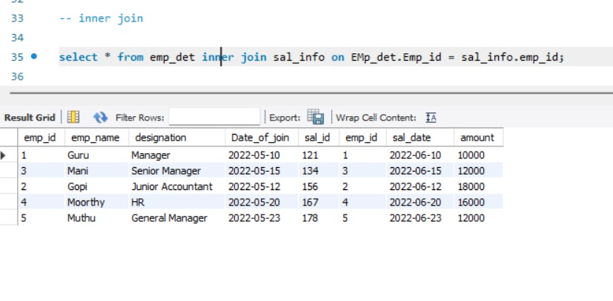
INNER JOIN The MySQL Inner Join is used to returns only those results from the tables that match the specified condition and hides other rows and columns.

Slide 66

LEFT JOIN The Left Join clause returns all the rows from the left table and matched records from the right table or returns Null if no matching record found. This Join can also be called a Left Outer Join clause.

Slide 67

RIGHT JOIN The Right Join is used to joins two or more tables and returns all rows from the right-hand table, and only those results from the other table that fulfilled the join condition.

Slide 68

FULL OUTER JOIN The FULL OUTER JOIN keyword returns all records when there is a match in left (table1) or right (table2) table records

Slide 69

CROSS JOIN MySQL CROSS JOIN is used to combine all possibilities of the two or more tables and returns the result that contains every row from all contributing tables.

Slide 70
PROCEDURE CONCEPT

Slide 71
PROCEDURE
Stored procedures are sub routines, segment of SQL statements which are stored in SQL catalog.
SYNTAX
delimiter //
create
procedure store_data()beginselect * from student where city_state in('chennai','madurai');select * from student where age >22;select age, count(student_id) as stu_count fromstudent group by age;end //delimiter ;call store_data();

Slide 72

OUTPUT

Slide 73
TRIGGER a database trigger is a stored program which is automatically fired or executed when some events occur.

Slide 74
TYPES OF TRIGGER
ROW LEVEL TRIGGER
A row-level trigger in SQL is a type of database trigger that is executed once for each row affected by a DML (Data Manipulation Language) statement such as INSERT, UPDATE, or DELETE. Row-level triggers allow you to define actions that occur for every row that is inserted, updated, or deleted in a table.

Slide 75
STATEMENT LEVEL TRIGGER
A statement-level trigger in SQL is a type of database trigger that is executed once per DML (Data Manipulation Language) statement, such as INSERT, UPDATE, or DELETE, regardless of how many rows are affected by that statement. This is different from row-level triggers, which execute once for each row that is affected by the statement.

Slide 76

TRIGGER TIMING – BEFORE INSERT Before Insert Trigger in MySQL is invoked automatically whenever an insert operation is executed

Slide 77

TRIGGER TIMMING – AFTER INSERT CONCEPT After Insert Trigger in MySQL is invoked automatically whenever an insert event occurs on the table.

Slide 78
LOAN ANALYTICS - HUB

Slide 79
Data Management, Interest Calculation, and Status Automation"
To manage the loan analytics hub, we first create and populate the tables: customer_income_status, loan_status, customer_info, country_state, and region_info.
We then join these tables using inner joins to retrieve comprehensive customer data.
Based on the customer's grade, we calculate monthly and annual interest amounts, and remove records with CIBIL scores greater than 200.
For loan statuses, we implement a trigger to set the status to "Loan Still Processing" for customers with a null CIBIL score.
We manually calculate interest rates using CASE statements. Finally, all queries are stored and executed via a stored procedure.

Slide 80

DATA SET

Slide 81
syntax
delimiter //create procedure overall()begin select loan_status.loan_id,loan_status.customer_id,loan_status.loan_amount,loan_status.loan_amount_term,loan_status.cibil_score,remarks_update.cibil_score_status,customer_income_status.applicantincome,customer_income_status.coapplicantincome,customer_income_status.property_area,customer_income_status.loan_status,customer_info.customer_name,customer_info.gender,customer_info.age,customer_info.married,customer_info.education,customer_info.self_employed,customer_info.region_id,country_state.postal_code,country_state.segment,country_state.state,region_info.region,casewhen (customer_income_status.applicantincome > 15000) then 'A_grade_customer'when (customer_income_status.applicantincome > 9000) then 'B_grade_customer'when (customer_income_status.applicantincome > 5000) then 'Middle_class_customer'when (customer_income_status.applicantincome < 5000) then 'Low_class_customer'end as customer_grades,casewhen (customer_income_status.applicantincome < 5000 and customer_income_status.property_area = 'Rural') then 3when (customer_income_status.applicantincome < 5000 and customer_income_status.property_area = 'Semi rural') then 3.5when (customer_income_status.applicantincome < 5000 and customer_income_status.property_area = 'Urban') then 5when (customer_income_status.applicantincome < 5000 and customer_income_status.property_area = 'Semi urban

Slide 82
') then 2.5else 7end as monthly_interest,round((loan_status.loan_amount * CASE WHEN customer_income_status.applicantincome <= 5000 AND customer_income_status.property_area = 'Rural' THEN 3 WHEN customer_income_status.applicantincome <= 5000 AND customer_income_status.property_area = 'Semi rural' THEN 3.5 WHEN customer_income_status.applicantincome <= 5000 AND customer_income_status.property_area = 'Urban' THEN 5 WHEN customer_income_status.applicantincome <= 5000 AND customer_income_status.property_area = 'Semi urban' THEN 2.5 ELSE 7 END / 100),0) AS monthly_interest_amount, round((loan_status.loan_amount * CASE WHEN customer_income_status.applicantincome <= 5000 AND customer_income_status.property_area = 'Rural' THEN 3 WHEN customer_income_status.applicantincome <= 5000 AND customer_income_status.property_area = 'Semi rural' THEN 3.5 WHEN customer_income_status.applicantincome <= 5000 AND customer_income_status.property_area = 'Urban' THEN 5 WHEN customer_income_status.applicantincome <= 5000 AND customer_income_status.property_area = 'Semi urban' THEN 2.5 ELSE 7 END / 100 *12),0) AS annual_interest_amount from loan_status inner join remarks_update on loan_status.loan_id = remarks_update.loan_id inner join customer_income_status on customer_income_status.loan_id = loan_status.loan_id inner join customer_info on customer_income_status.customer_id = customer_info.customer_idinner join country_state on customer_info.customer_name = country_state.customer_name inner join region_info on country_state.region_id = region_info.region_id;select * from country_state right join region_info on country_state.region_id = region_info.region_id;end //delimiter ;call overall();

Slide 83

output

Slide 84
Thank YOU

